Slide 1
Diamond Price Prediction
Group :
Mohamed Gamal
Amira Djaiz
Aya Abu Dabbur
Mai Serry
Dyaa Dwekat
Supervisor:
Saad Altamari

Slide 2
Content
Introduction
Data Loading and Exploration
Data Visualization
Data Cleaning
Feature Engineering and Data Preparation
Preparing Model
Fine-Tuning the Model
Submission

Slide 3
Structure
Step 01
Data Loading and Exploration
Step
02
Data Visualization
Step 03
Data Cleaning
Step 04
Feature Engineering
Step 05
Preparing Model
Step
06
Fine-Tuning the Model
Step 07
Evalute Final Model
Step 08
Submission

Slide 4
Introduction

Slide 5

Introduction
Background
Objective
Understanding the complexities of diamond pricing, which depends on the 4Cs (Carat, Cut, Color, Clarity), is essential. These attributes interact in complex ways, making accurate price prediction a challenging task.
Our goal is to develop a robust machine-learning model that can predict diamond prices accurately. This involves thorough data analysis and selecting the best predictive techniques.

Slide 6
Data Loading and Exploration

Slide 7
Data Loading
The first step of the project involved loading the training data.

Slide 8
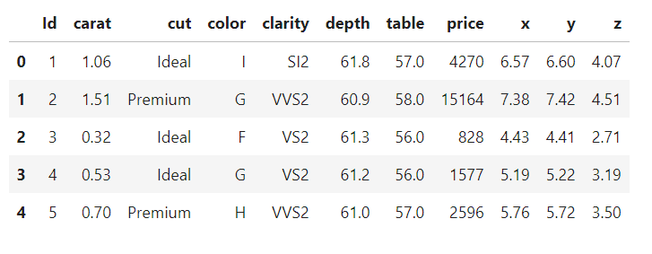
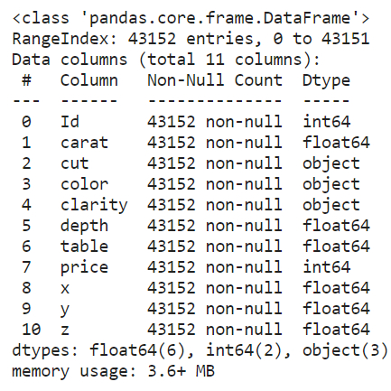
Data Exploration
df.head()
df.info()
Notes:
We performed an initial exploration to understand its structure and characteristics. This included:
Displaying the Data: We used the head () function to display the first few rows of the dataset.
Exploring Data Information: The info () function was used to obtain information about the dataset, including the data types of each column and the presence of any missing values.
Descriptive Statistics: We used the describe () function to generate descriptive statistics for numeric features, such as mean, standard deviation, minimum, maximum, and quartile values.

Slide 9
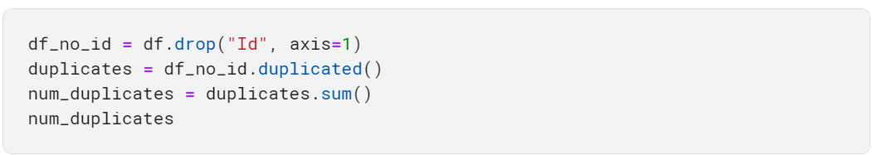
Data Preprocessing
Removing Irrelevant Columns: The 'Id' column was determined to be unnecessary for our analysis and was thus removed from the dataset.
Notes:
Removing Irrelevant Columns: The 'Id' column was determined to be unnecessary for our analysis and was thus removed from the dataset.
Handling Duplicates: We observed that the dataset contained duplicate rows. Using the drop_duplicates() function with the parameter keep='first', we removed all duplicate rows while retaining the first occurrence of each duplicated row.

Slide 10
Data Visualization

Slide 11
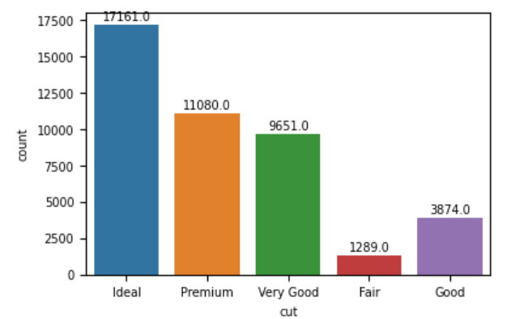
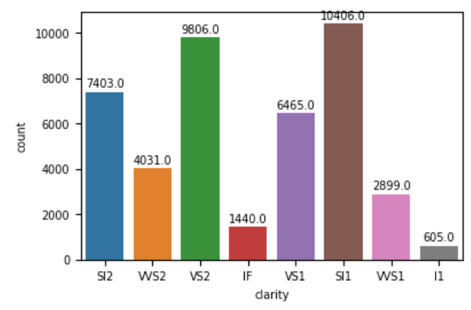
Data Visualization
Countplot for Cut
Countplot for Clarity
Notes:
To understand the distribution of data across different cut and clarity categories, we utilized a countplot. Here's what we found:
Cut Distribution: The Ideal cut category is the most common, followed by Premium, Very Good, Good, and Fair. Clarity Distribution: The SI1 clarity category is the most prevalent, followed by VS2, SI2, VS1, and VVS2.

Slide 12
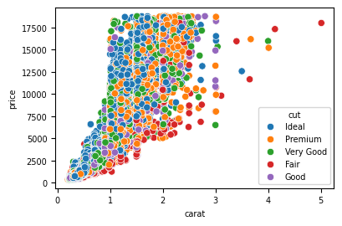
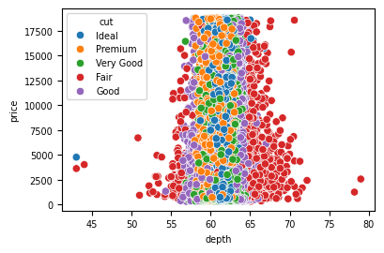
Data Visualization
Scatterplot for Carat vs. Price:
Scatterplot for Depth vs. Price:
Notes:
2.2 Scatterplot for Carat and Price
Next, we conducted a scatterplot analysis to explore the relationship between carat, depth, and price features. Our findings were as follows:
Carat vs. Price: The scatterplot revealed a positive correlation between carat and price, indicating that as carat increases, the price of the diamond tends to increase as well. Additionally, we observed that diamonds with a Fair cut tend to have their highest prices at carat values larger than around 4, with a peak price observed at carat 5.
Depth vs. Price: Contrary to our expectations, we found no significant relationship between depth and price. The scatterplot did not show a clear pattern or trend between these two variables.

Slide 13
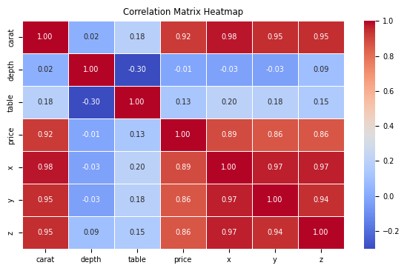
Data Visualization
Heatmap for Feature
Correlation
(for numeric features)
Notes:
High Correlations: Strong correlations exist between diamond price and attributes such as carat and dimensions (x, y, z). These factors are closely related and likely influential in determining diamond prices.
Weak Negative Correlation: We observed a weak negative correlation between depth and table. This suggests that as one of these attributes increases, the other tends to decrease slightly.

Slide 14
Data Cleaning
Notes:
We first checked if the numeric features included any zero or negative values. The result showed that there were 17 such values. Upon investigation, it was found that these values were present in the 'z' (depth) column. Since zero values are not logical for dimensions columns, we decided to drop those rows.

Slide 15
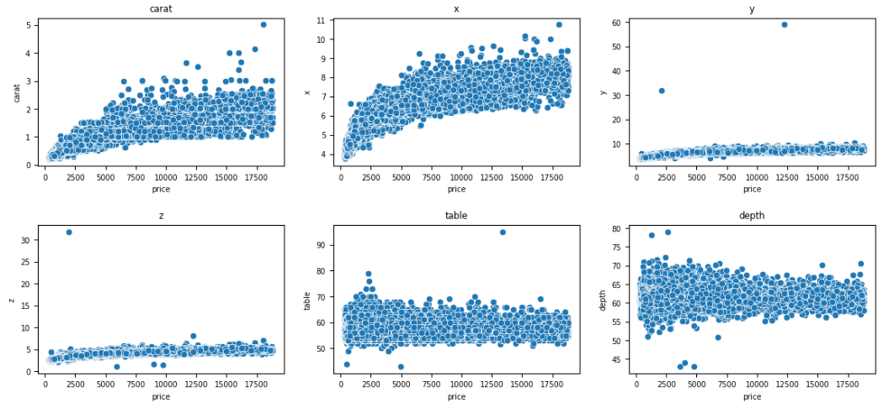
Data Cleaning
Handling Outliers
Notes:
To handle outliers, we visualized the data using scatterplots for all features.
Then, we manually defined a condition to identify outliers and then dropped the corresponding rows. This resulted in the removal of 11 outliers, including instances where:
Carat and X: These features appeared to have reasonable distributions and were considered suitable for further analysis.
Y and Z: Values above 10 were considered outliers and were removed.
Table: Values above 80 were considered outliers and were removed.
Depth: Values below 50 or above 75 were considered outliers and were removed

Slide 16
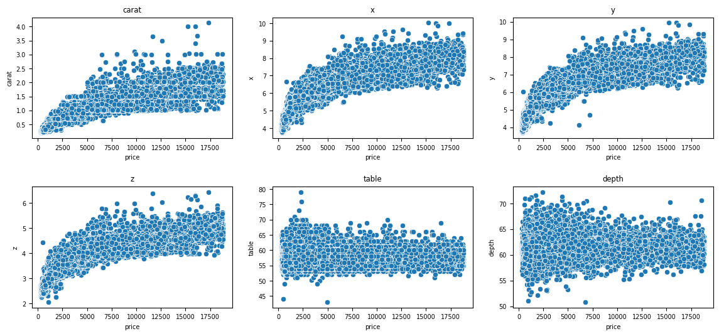
Data Cleaning
Notes:
3.3 Removing Values Below 2 in Z (Depth) Feature
Additionally, we identified values below 2 in the 'z' (depth) feature as outliers. These outliers were removed from the dataset.

Slide 17
Feature Engineering and Data Preparation

Slide 18
Feature Engineering
01
Feature Engineering
02
Adding Volume Feature
03
Dropping Columns
04
Ordinal Encoding
Notes:
4.1 Feature Engineering
We began by defining a function called volume_of_diamond. This function calculates the volume of each diamond based on its dimensions. It extracts the length, width, depth, and max width from each row, computes the areas of the faces, and then uses these values to calculate the volume for each diamond.
import math
def volume_of_diamond(row):
# Extracting length, width, and depth from the row
length = row['x']
width = row['y']
depth = row['z']
max_width=row['table']
# Calculate the areas of the faces
area_larger_face = length * max_width
area_smaller_face = width ** 2
# Calculate the volume
volume = (1/3) * depth * (area_larger_face + area_smaller_face + math.sqrt(area_larger_face * area_smaller_face))
return volume
4.2 Adding Volume Feature
After defining the function, we applied it to the dataset to calculate the volume for each diamond. The calculated volume values were then added as a new feature to the dataset.
processed_df = df.copy()
processed_df['volume'] = processed_df.apply(volume_of_diamond, axis=1)
processed_df.drop(['x', 'y', 'z'], axis=1, inplace=True)
processed_df[:10]
4.3 Dropping Columns
Since the volume feature was derived from the 'x', 'y', and 'z' columns, which are no longer needed, we dropped these columns from the dataset.
4.4 Ordinal Encoding
Ordinal encoding was performed for the categorical features (color, cut, clarity) to represent the categorical values as rank numeric values. This encoding facilitates machine learning algorithms' understanding of categorical data.
from sklearn.preprocessing import OrdinalEncoder
enc_processed_df = processed_df.copy()
# Ordering each category
colors_cats = ['J', 'I', 'H', 'G', 'F', 'E', 'D']
cuts_cats = ['Fair', 'Good', 'Very Good', 'Premium', 'Ideal']
clarities_cats = ['I1', 'SI2', 'SI1', 'VS2', 'VS1', 'VVS2', 'VVS1', 'IF']
# Transform ordinal columns
ord_enc = OrdinalEncoder(categories=[colors_cats, cuts_cats, clarities_cats])
diamond_cats_encoded = ord_enc.fit_transform(enc_processed_df[['color', 'cut', 'clarity']])
enc_processed_df[['color','cut','clarity']] = diamond_cats_encoded
enc_processed_df.head()

Slide 19
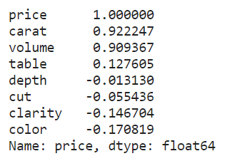
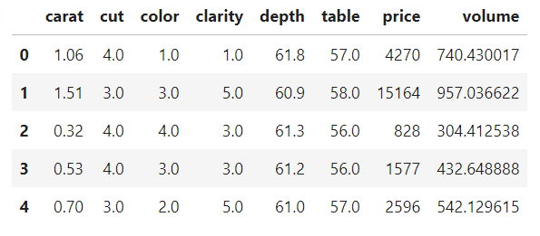
Feature Engineering
enc_processed_df.corr()
enc_processed_df.head()
Notes:
4.1 Feature Engineering
We began by defining a function called volume_of_diamond. This function calculates the volume of each diamond based on its dimensions. It extracts the length, width, depth, and max width from each row, computes the areas of the faces, and then uses these values to calculate the volume for each diamond.
import math
def volume_of_diamond(row):
# Extracting length, width, and depth from the row
length = row['x']
width = row['y']
depth = row['z']
max_width=row['table']
# Calculate the areas of the faces
area_larger_face = length * max_width
area_smaller_face = width ** 2
# Calculate the volume
volume = (1/3) * depth * (area_larger_face + area_smaller_face + math.sqrt(area_larger_face * area_smaller_face))
return volume
4.2 Adding Volume Feature
After defining the function, we applied it to the dataset to calculate the volume for each diamond. The calculated volume values were then added as a new feature to the dataset.
processed_df = df.copy()
processed_df['volume'] = processed_df.apply(volume_of_diamond, axis=1)
processed_df.drop(['x', 'y', 'z'], axis=1, inplace=True)
processed_df[:10]
4.3 Dropping Columns
Since the volume feature was derived from the 'x', 'y', and 'z' columns, which are no longer needed, we dropped these columns from the dataset.
4.4 Ordinal Encoding
Ordinal encoding was performed for the categorical features (color, cut, clarity) to represent the categorical values as rank numeric values. This encoding facilitates machine learning algorithms' understanding of categorical data.
from sklearn.preprocessing import OrdinalEncoder
enc_processed_df = processed_df.copy()
# Ordering each category
colors_cats = ['J', 'I', 'H', 'G', 'F', 'E', 'D']
cuts_cats = ['Fair', 'Good', 'Very Good', 'Premium', 'Ideal']
clarities_cats = ['I1', 'SI2', 'SI1', 'VS2', 'VS1', 'VVS2', 'VVS1', 'IF']
# Transform ordinal columns
ord_enc = OrdinalEncoder(categories=[colors_cats, cuts_cats, clarities_cats])
diamond_cats_encoded = ord_enc.fit_transform(enc_processed_df[['color', 'cut', 'clarity']])
enc_processed_df[['color','cut','clarity']] = diamond_cats_encoded
enc_processed_df.head()

Slide 20
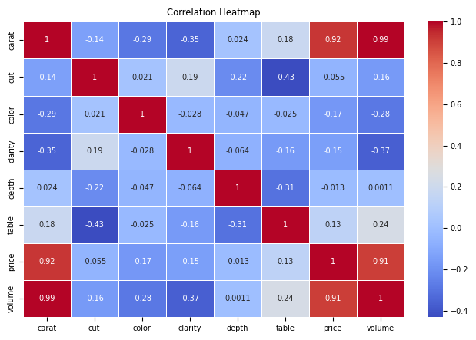
Data Exploration
Correlation Matrix: Calculated the correlation matrix to examine the relationships between different features.
Notes:
We conducted data exploration by performing the following:
Correlation Matrix: Calculated the correlation matrix to examine the relationships between different features.
Descriptive Statistics: We used the describe() function to generate descriptive statistics for the new dataset.
4.6 Heatmap Visualization
A heatmap was used to visualize the correlation matrix. Notably, the heatmap revealed that the volume feature has the highest positive correlation with the price, with a correlation coefficient of 0.91

Slide 21
Preparing Models

Slide 22
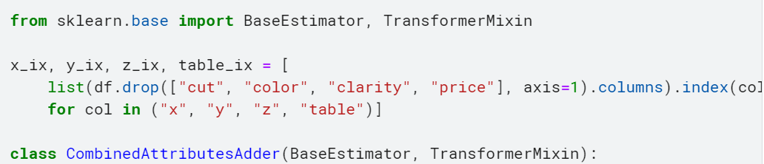
Preparing Model
Custom Transformer for Feature Engineering
We define a custom transformer CombinedAttributesAdder to generate a new feature, volume, based on the diamond dimensions:

Slide 23
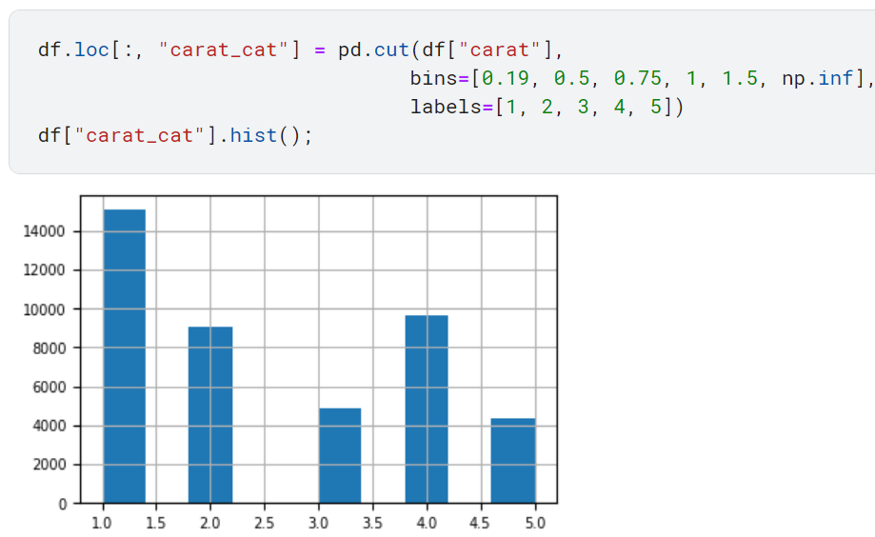
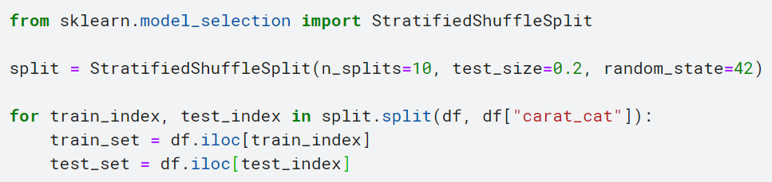
Preparing Model
Splitting the Data
Notes:
We Use stratified sampling to split the data based on carat weight categories.
By using stratified sampling based on carat weight, we ensure that both the training and testing sets are representative of the overall dataset, reducing sampling bias and improving model evaluation.

Slide 24
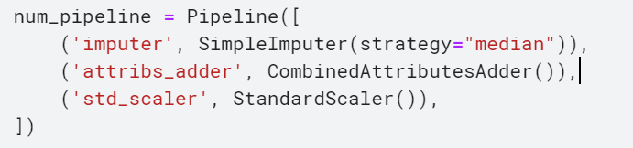
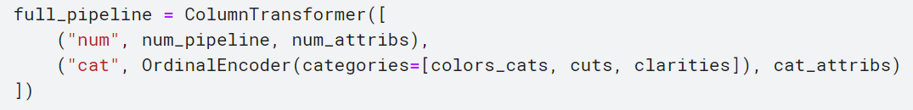

Preparing Model
Numerical Pipeline
Full Pipeline
Data Transformation
Notes:
We create separate pipelines for numerical and categorical data preprocessing. The numerical pipeline includes a SimpleImputer to replace missing values with the median, a custom CombinedAttributesAdder to calculate and add the diamond's volume, and a StandardScaler to normalize the data. We use ColumnTransformer to integrate both pipelines and apply the appropriate transformations to the training data.

Slide 25
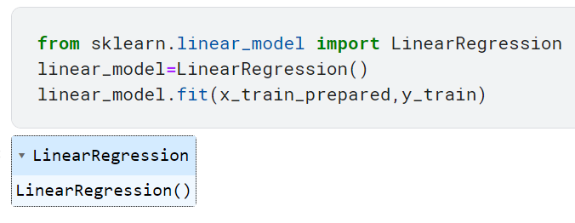
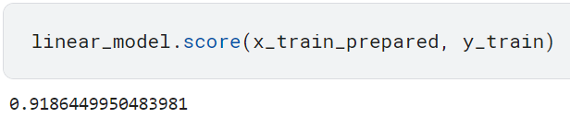
Linear Regression model
We evaluate the model's performance on the training set.

Slide 26
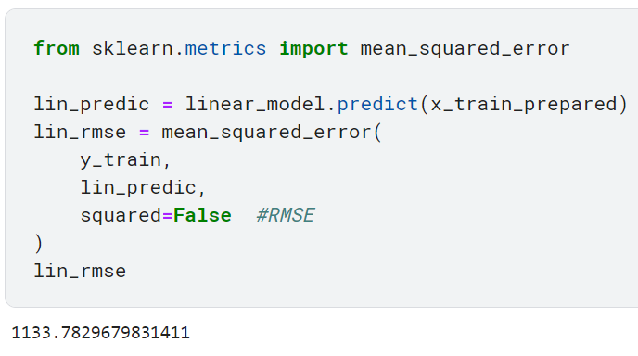
Linear Regression model
Calculating RMSE on Training Data.

Slide 27
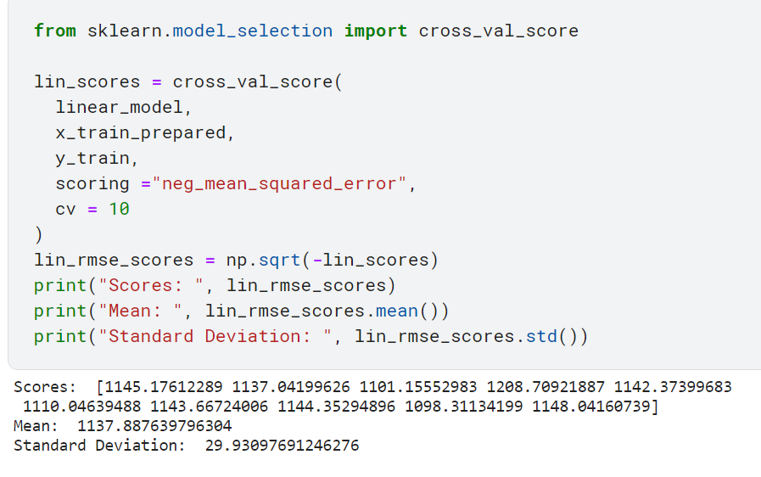
Linear Regression model
use cross-validation to evaluate the model's performance.
Notes:
Mean RMSE (Root Mean Squared Error): 1215.98
Standard Deviation of RMSE: 29.97
This indicates that, on average, the model's predictions deviate from the actual prices by approximately $1137.98. The standard deviation of 29.97 suggests that the RMSE values across the cross-validation folds are relatively consistent, indicating stable performance.

Slide 28
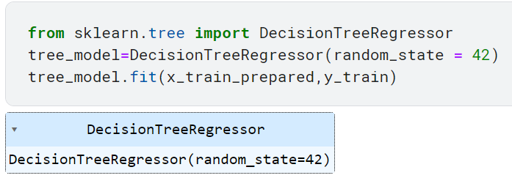
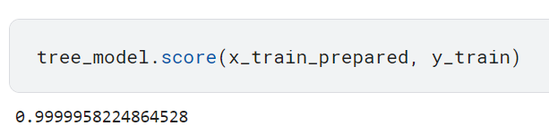
Decision Tree Regressorion Model
We evaluate the model's performance on the training set.

Slide 29
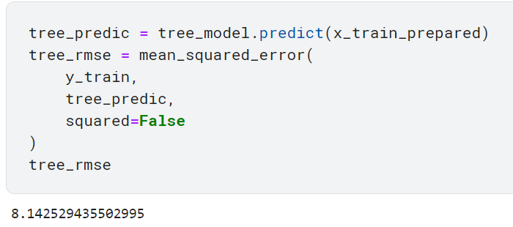
Decision Tree Regressorion Model
Calculating RMSE on Training Data.

Slide 30
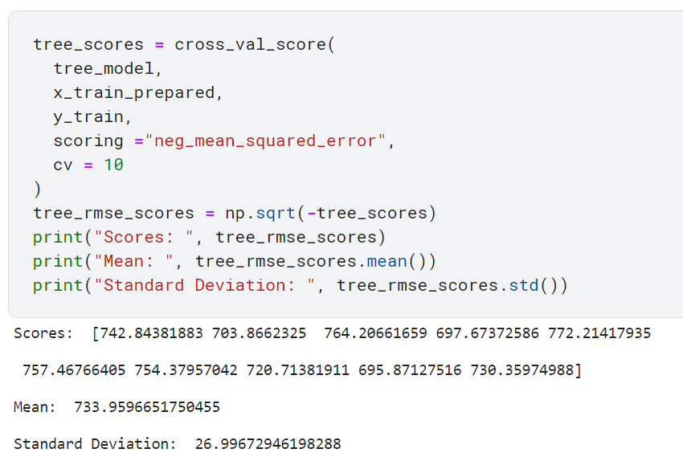
Decision Tree Regression Model
use cross-validation to evaluate the model's performance.
Notes:
Mean RMSE (Root Mean Squared Error): 733.63
Standard Deviation of RMSE: 26.4
This indicates that, on average, the model's predictions deviate from the actual prices by approximately $733 The standard deviation of 26,4 suggests that the RMSE values across the cross-validation folds are relatively consistent, indicating stable performance.

Slide 31
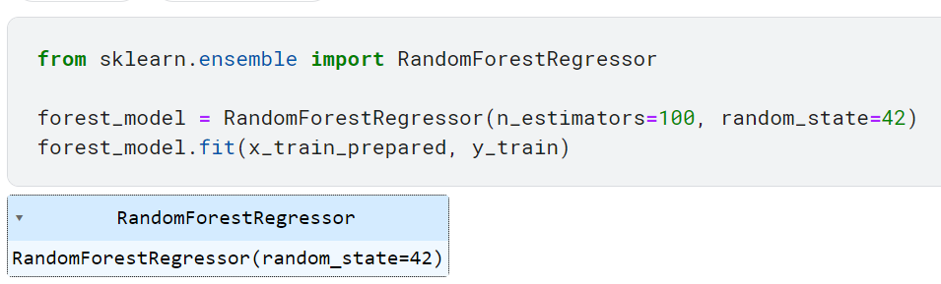
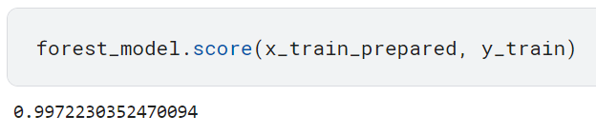
RandomForest Regressor Model
We evaluate the model's performance on the training set.

Slide 32
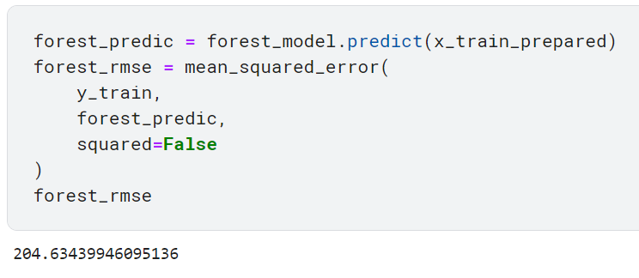
RandomForest Regressor Model
Calculating RMSE on Training Data.

Slide 33
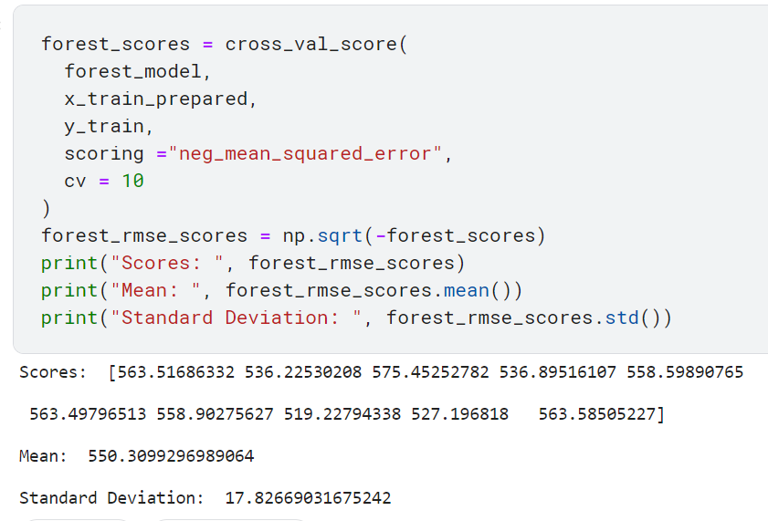
RandomForest Regressor Model
use cross-validation to evaluate the model's performance.
Notes:
Mean RMSE (Root Mean Squared Error): 550.98
Standard Deviation of RMSE: 17
Compared to both the Linear Regression and Decision Tree models, the Random Forest model demonstrates the lowest mean RMSE, suggesting that it provides the most accurate predictions on average. Additionally, its standard deviation of 17 indicates consistent performance across the cross-validation folds.

Slide 34
Fine-Tuning the Model

Slide 35
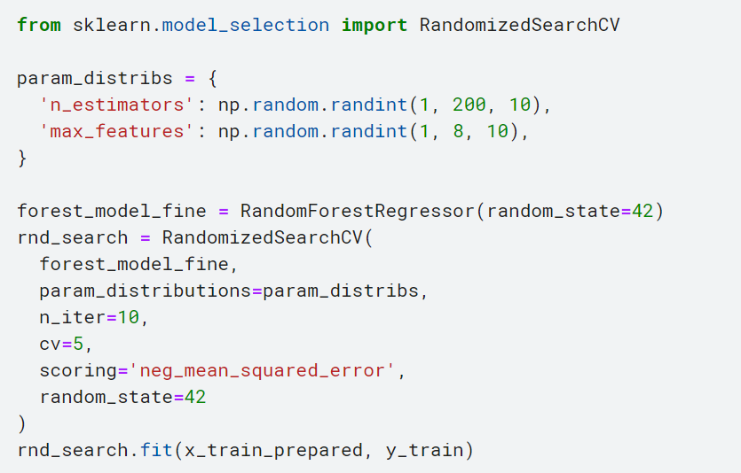
Fine-Tuning the Model
Notes:
We fine-tune our model to optimize performance by importing the RandomizedSearchCV class from scikit-learn. We define the hyperparameters to tune in a dictionary and initialize a RandomForestRegressor with a fixed random state. Using RandomizedSearchCV, we systematically search through different hyperparameter combinations, fitting it to our training data and evaluating each combination with cross-validation.

Slide 36
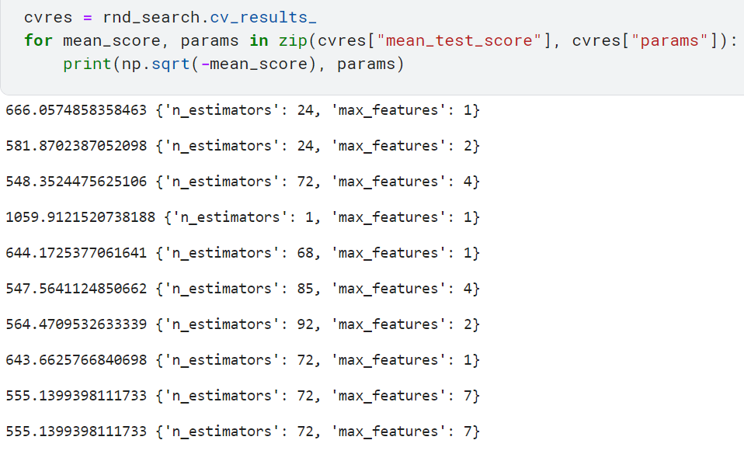
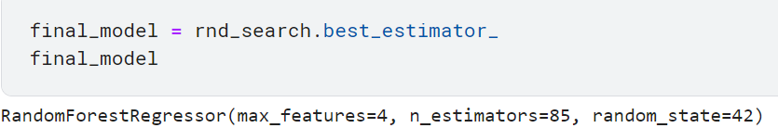
Fine-Tuning the Model
The best-performing set of parameters is {'n_estimators': 72, 'max_features': 4}which resulted in the lowest RMSE of 548.35.
Notes:
Once the search is completed, we access the cross-validation results through rnd_search.cv_results_. We iterate through these results, printing out the root mean squared error (RMSE) and the corresponding hyperparameters for each combination.
finally, we pick the best model we found in the search and save it as "final_model." This model holds the best combination of settings we discovered while fine-tuning.

Slide 37
Evalute Final Model

Slide 38
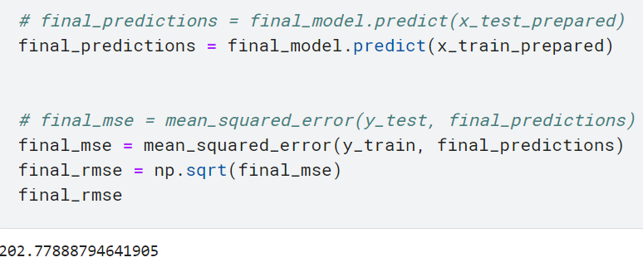
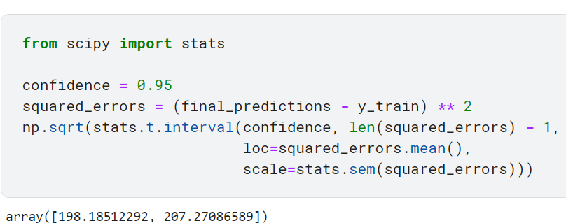
Evalute Final Model
Calculate the confidence interval for the Root Mean Square Error (RMSE) of the final model's predictions.
Notes:
The resulting confidence interval gives us a range within which we expect the true RMSE to lie, providing insight into the model's accuracy and reliability.

Slide 39
Submission

Slide 40
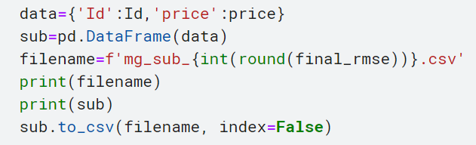
Submission
the first few rows of our submission file:
Id | price
1 | 839.1597
2 | 2905.8908
3 | 875.2437
4 | 2753.8571
5 | 1054.3025
... | ...
10786 | 4347.8571
10787 | 4786.2605
10788 | 13905.1765
Notes:
Each row represents a diamond from the test set, with its corresponding predicted price.

